Slide 1


PANIMALAR ENGINEERING COLLEGE
DEPARTMENT OF COMPUTER SCIENCE AND ENGINEERING
CS8811 PROJECT WORK
PROJECT REVIEW
A Decentralized application (DApp) on Trading of Real Estate
Assets using Blockchain and Artificial Intelligence.
Guide Name: Mr. Karthikeyan A, Assistant Professor
Team: Darin Joshua D (211418104043)
Gladwin Joseph Solomon B (211418104064)
Joel Nithish Kumar M (211418104102)
BATCH NO: E7

Slide 2
Abstract:
In recent years, the emergence of blockchain technology (BT) has become a unique, most disruptive, and trending technology. The decentralized database in BT emphasizes data security and privacy. Also, the consensus mechanism in it makes sure that data is secured and legitimate. Still, it raises new security issues such as majority attack and double-spending. To handle the issues, data analytics is required on blockchain based secure data. Analytics on these data raises the importance of arisen technology Machine Learning (ML). ML involves the rational amount of data to make precise decisions.
Data reliability and its sharing are very crucial in ML to improve the accuracy of results. The combination of these two technologies (ML and BT) can provide highly precise results. The design and operation of a blockchain involve thousands of parameters and tradeoffs between security, performance, decentralization, and many others. Artificial intelligence can ease those decisions and automate and optimize blockchain for higher performance and better governance. Moreover, as all data on blockchain is publicly available, AI plays a key role in providing users confidentiality and privacy.

Slide 3
Introduction:
A blockchain is a distributed database/ledger that is shared among the nodes of a computer network. As a database, a blockchain stores information electronically in digital format in a distributed network without any central entity architecture.
Artificial intelligence (AI) and Blockchain have become two of the most trending and disruptive technologies especially with the rise of the Web 3.0 which is going to make the internet more secure and reliable than its predecessors. AI combined with Blockchain technology provides access to a shared ledger of data, transactions, and logs in a decentralized, secure and trusted manner with a Distributed Artificial Intelligence making the algorithms having a distributed yet common goal.
Decentralized applications (DApps) are digital applications or programs that exist and run on a blockchain or peer-to-peer (P2P) network of computers instead of a single computer. DApps are outside the preview and control of a single authority.
DApps - which are often built on the Ethereum platform—can be developed for a variety of purposes including gaming, finance, real estate and social media to solve security and reliability problems.

Slide 4

Literature Survey:
[1] A. Tapscott and T. Don, How blockchain is changing finance (2017) | This explains how two or more parties, whether businesses or individuals who may or may not know each other, can use blockchain to avoid forged agreements, make transactions, and build value without relying on intermediaries to verify their identities, establish trust, or perform critical business logic like contracting, clearing, settling, and record-keeping tasks that are foundational to all forms of commerce.
[2] Blockchain for Real Estate Yarlagadda Jyotsna, Keerthi Gampala (2020) | Despite the importance of real estate in a country's economy, the existing system has numerous flaws ranging from property searches to property agreements, sale and purchase, transaction of money, and the role of middleman. Real estate and blockchain can work together. The land business process can use the blockchain model to firmly establish the real estate concept in more than one of its wearing exercises.

Slide 5
Literature Survey:
[3] An Overview on Integrating Machine Learning with Blockchain Kevin Shaju Varghese (2019) | Machine learning and blockchain are two of the most disruptive technologies that will radically alter how we live, work, and interact. Furthermore, smart contracts enable blockchain to manage interactions between members without the need for an intermediary or a trusted third party. For many components of machine learning, including as data, algorithms, and computing power, blockchain can power decentralized marketplaces and coordination platforms.
[4] Decentralized Applications: The Blockchain-Empowered Software System - Wei Cai , Zehua Wang (2018) | Blockchain systems provide infrastructure for decentralized applications by combining cryptography, peer-to-peer networking, and consensus methods. In this paper they have analyzed the history of blockchain technology and defined their popular meanings in this article. They have proposed DApp application scenarios, which we believe will be the focus of future blockchains. They have also covered ideal dApp traits and recent blockchain development initiatives, such as payment channels, unique consensus methods, and non-public blockchains.

Slide 6
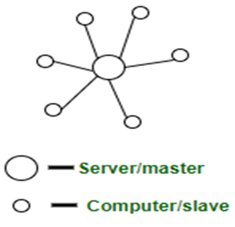
Problem Statement:
The current system is centralized and has separate services which uses a client/server architecture and is maintained & owned by a central organization. E.g: Airbnb, Home Away.
There is a hidden transaction fee or commission for every transaction involved.
Each transaction and customer details are stored in a central server and the user has no control over their data as it is owned and managed by an organization which can manipulate the prices, information and resources according to their business needs.
There is no graceful degradation due to the Centralized server.
Lesser security and privacy of the user resources and data.

Slide 7
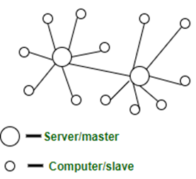
Proposed System:
A decentralized application for trading of physical assets such as House/Land/Vehicles based on Web 3.0 connected using blockchain entities and Artificial Intelligence.
A simple blockchain or peer to peer system which does not involve any transaction fee/commission which is integrated with AI for enhanced features of the decentralized network handling (DAI).
Every buy/sell/rent transaction is stored in a block which is linked with the previous block making it almost impossible to tamper due to the concept of hashing, providing security, confidentiality and integrity.
Pros:
Real estate and asset transactions require a ton of paperwork to verify financial information and ownership and then transfer deeds and titles to new owners. Using blockchain technology and AI to record real estate transactions can provide a more secure and accessible means of verifying and transferring ownership. That can speed up transactions, reduce paperwork, remove need of middleware or commissions and save money.
There is no possibility of downtime as it is decentralized and not dependent on
a central server or a single entity.
Provides more security and privacy to the user resources and data as
It does not place user data in a server managed by a single entity
Instead stores data in blockchain or peer to peer network which runs autonomously.

Slide 8

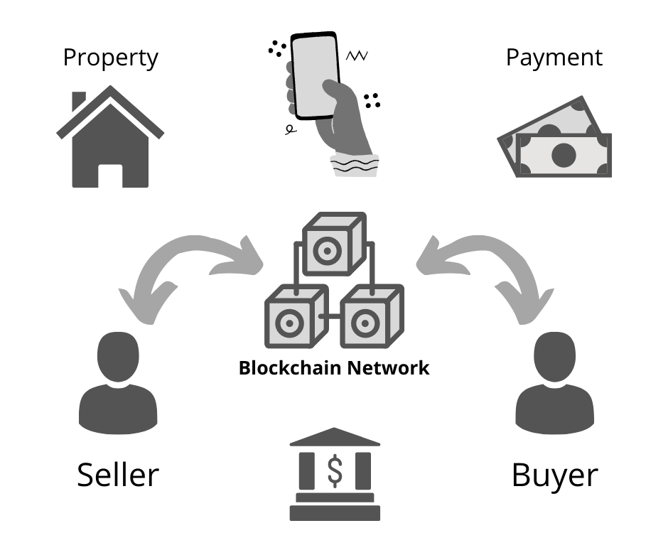
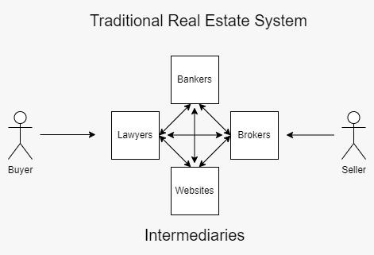
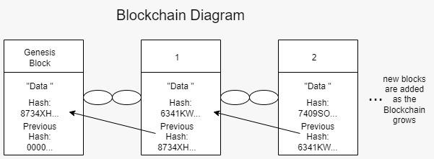
Traditional System vs Blockchain based System:

Slide 9
Software Environment:
Operating system must run a stable build with the latest version of a browser supporting web 3.0 and pertaining to the below requirements:
Domain : Blockchain and Artificial Intelligence
OS : Linux Distros / Windows 7 / macOS 10.15 (Catalina) or above
Browser : Latest Version of Chrome, Edge or Firefox
Platforms : Visual Studio Code Editor, Ethereum Platform, GitHub, DApp Test
Languages : Python, Javascript, Solidity, HTML, CSS, JSON, etc
Packages : All the required dependencies, packages and requirements
Tools : AI/ML frameworks (TensorFlow, Pytorch, Keras, Streamlit, etc), React NextJS, Ganache, Metamask, Ethereum, Auth0, CollectChat, Tally, Heroku, Vercel, Project Management (Clickup), Node, CLI

Slide 10
Hardware Environment:
Desktop or a Laptop (also can be accessed through a smartphone) with a good internet connection and the below requirements: -
Processor : Intel Pentium Dual Core 2.00GHz or above
Hard disk : 500 GB or above
RAM : 8 GB (minimum)
Network : 3 Mbps or above

Slide 11
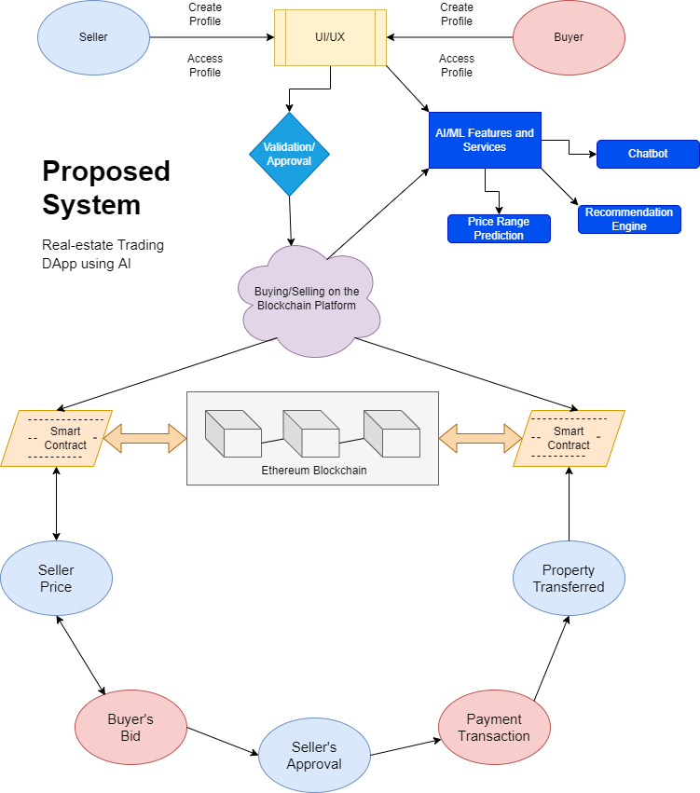
System Architecture Flow Diagram:

Slide 12
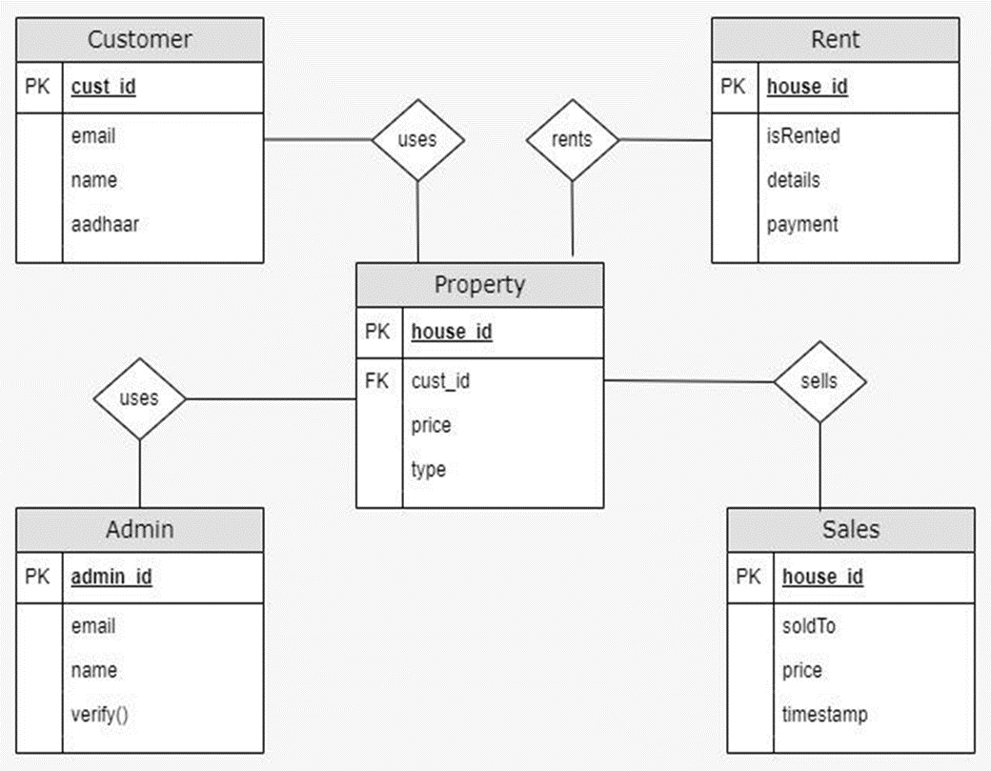
System Design:
ER Diagram:

Slide 13
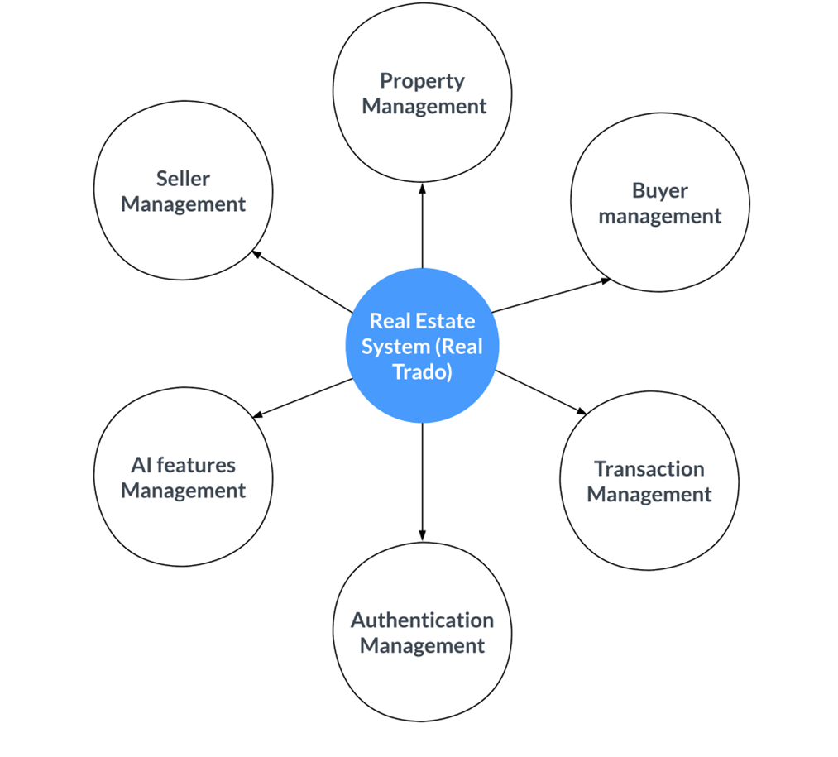
System Design:
Level 0 DFD:

Slide 14
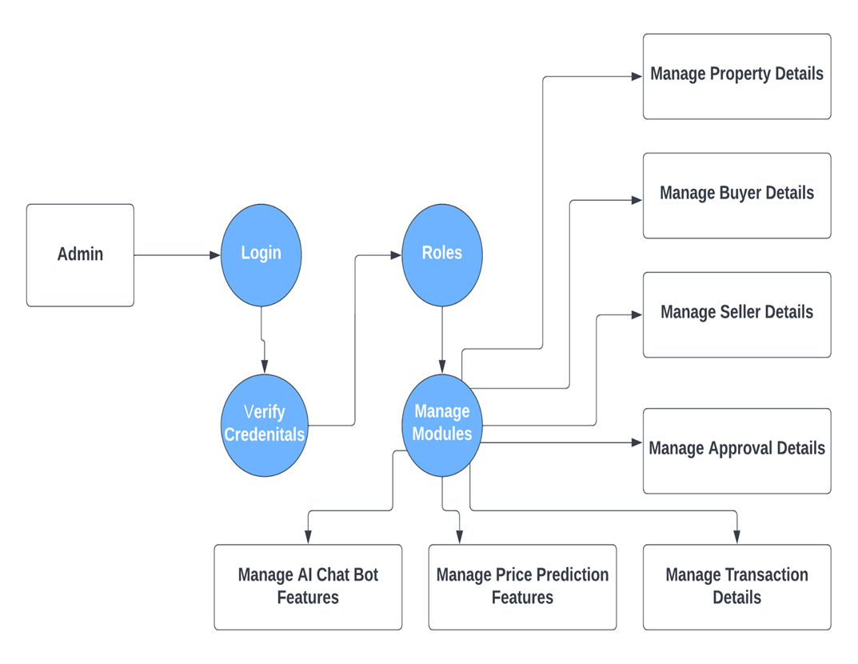
System Design:
Level 1 DFD:

Slide 15
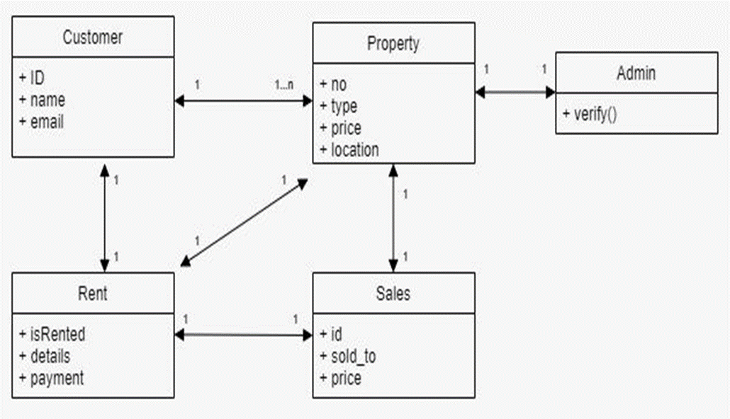
System Design:
Class Diagram:

Slide 16
Module Description:
FRONTEND UI/UX DESIGN
The frontend is built as an intuitive and interactive user interface or user experience on the blockchain network with a combination of various AI features. All are integrated as a unified DApp platform. It is built using the React NextJS framework which is based on Node to create a wholesome and formulated structure to the overall application. NextJS is one of the most used frameworks and will be great for Web 3.0 applications. The site gets data from various seller listings posted into the site after admin approval also includes an API integration of the different properties available.
BLOCKCHAIN NETWORK AND PAYMENT GATEWAY
Once the buyer has picked their choice of property, they can confirm their interest by doing the payment through the DApp. The payment (transactions) in this DApp is done through the Blockchain and ideally a person needs to have money in the wallet which can be in the form of any crypto currency or in their native currency (₹ in case of India, for this project it is $). In this DApp, we have used a local Blockchain network using Ganache and have minted DAI tokens which are stable coins with a standard value and converted them to dollars to show the working of the Blockchain. DAI (formerly SAI) is a stablecoin cryptocurrency on the Ethereum blockchain which aims to keep its value as close to one United States Dollar (USD). The transaction will be completed instantly no matter how much money is involved. Also there are no hidden charges.

Slide 17
Module Description:
CONVERSATIONAL AI (CHATBOT)
The conversational AI or chatbot plays an indisputable role in the modern web applications and the Web 3.0 based DApp will continue the trend to provide support and query responses to various queries of the users. This AI feature not only helps the users to interact with the platform easily but also gives the users and the admins the freedom of answering the questions and getting various responses. It is an excellent support tool, the chatbot is built using the AI collect chat API and is trained to give a variety of responses from support to booking calls to the admins. The user interface and the chatbot is integrated, called as the “Real Trado Assistant” which enables the functions of the unified platform.
AI RECOMMENDATION AND PRICE COMPARISON ENGINE
AI Recommendation and Price comparison combines two of the most powerful machine learning models where the train data uses nearly 5000 different data of the real estate properties dataset. The properties under the listings and API are used as the test data and the results are provided with high accuracy.

Slide 18
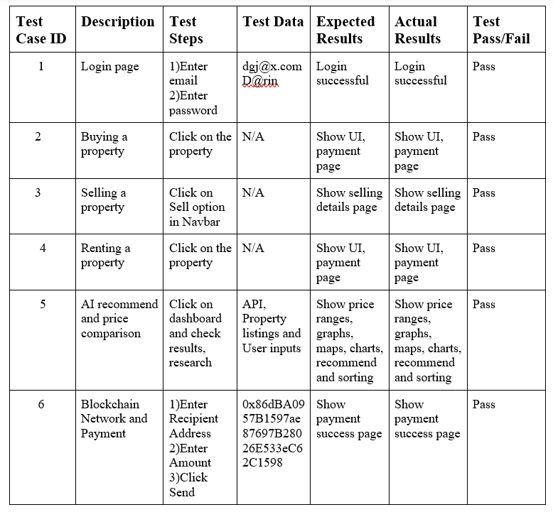
Testing and Evaluation:

Slide 19
Results:
The project prototype of the DApp is built after refinements and made available for users over the internet as it is hosted and deployed. This platform would be one of the beginning concepts of Web 3.0 that has been made into a working system. It enables all the specifications and features listed in the above headings required for real estate trading. The blockchain and artificial intelligence concepts well integrated makes it an extremely useful real world application with few more refinements can make it much more refined and more feature rich.
Final Deployment of the project prototype:
https://real-trado-dapp.vercel.app/ (or) https://real-trado.vercel.app/

Slide 20
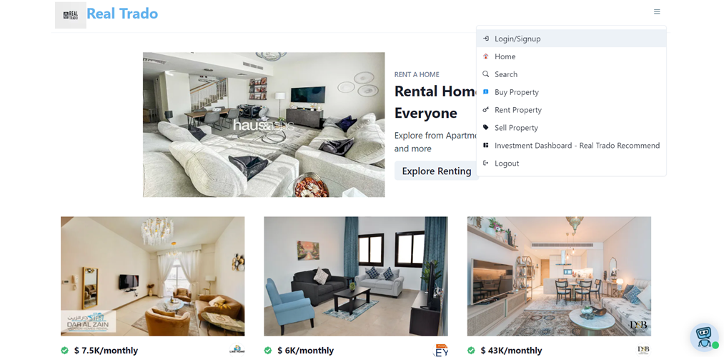
Screenshots:
Home Page

Slide 21
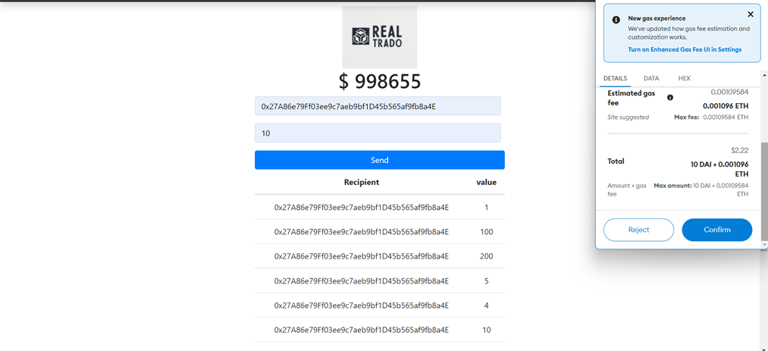
Screenshots:
Blockchain Transaction Page

Slide 22
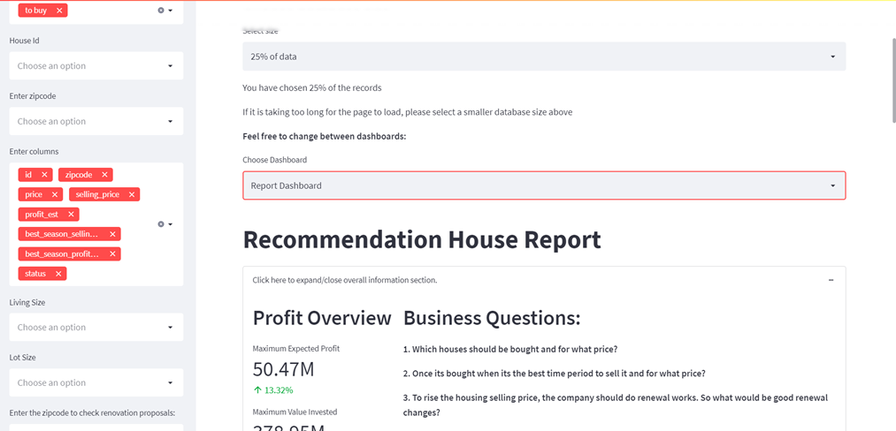
Screenshots:
AI Price and Recommendation Engine

Slide 23
Conclusion:
The Traditional Real Estate system is replaced with the Decentralized Application (DApp) through which the transactions and agreements can be made in a more efficient way. Moreover, it provides transparency and security which is of utmost importance in the present times. Some of the conclusions that can be made are listed below:-
(i) Blockchain provides a secure, fast and reliable means of transferring the assets.
(ii) Artificial Intelligence makes it possible for the user to see the expected price and also provides better suggestions based on the input from the user.
(iii) The overall process can be more environmentally friendly than the traditional system as it doesn’t involve the transportation, manpower and paperwork that the traditional system needs. But it is equally important to know that the Blockchain needs a considerable amount of computational power to store the transactions in each block which might be the only downside of a system using Blockchain.
(iv) Building DApps will take some time and effort but the outcome of a DApp is a purely peer to peer system that provides a secure way of transferring data without the intermediary which is always present in a traditional system.

Slide 24
Publication:
Joel Nithish Kumar M, Karthikeyan A, Darin Joshua D and Gladwin Joseph Solomon B. A Decentralized Application (DApp) on Trading Real Estate Assets using Blockchain and Artificial Intelligence, May 10, 2022, Journal Of Algebraic Statistics (JOAS), Indexed in the Emerging Sources Citation Index - Web of Science (Clarivate Analytics), Volume 13, No. 1, 2022, p. 216-224 https://publishoa.com/index.php/journal/article/view/78 ISSN: 1309-3452 216.

Slide 25
References:
[1] A. Jeppsson and O. Olsson, Jun. 2017. ‘‘Blockchains as a solution for traceability and transparency,’’ Packag. Logistics, Lund Univ., Lund, Sweden, Student Paper, Tech. Rep.,
[2] A. Narayanan, J. Bonneau and E. Felten, Bitcoin and Cryptocurrency Technologies: A comprehensive Introduction. 1st ed. Princeton, New Jersey: Princeton University Press, 2016
[3] Alisha Kuvalekar, Shivani Manchewar, Sidhika Mahadik, Shila Jawale. Posted: 3 Apr 2020. House Price Forecasting Using Machine Learning, Proceedings of the 3rd International Conference on Advances in Science & Technology (ICAST) 2020. https://papers.ssrn.com/sol3/papers.cfm?abstract_id=3565512

Slide 26
References:
[4] Ch. Rupa, Divya Midhunchakkaravarthy, Mohammad Kamrul Hasan, Hesham Alhumyani, Rashid A. Saeed, 2021. Industry 5.0: Ethereum blockchain technology based DApp smart contract.
[5] G. Naga Satish, Ch. V. Raghavendran, M.D.Sugnana Rao, Ch.Srinivasulu. International Journal of Innovative Technology and Exploring Engineering (IJITEE) ISSN: 2278-3075, Volume-8 Issue-9, July 2019. House Price Prediction Using Machine Learning https://www.ijitee.org/wp-content/uploads/papers/v8i9/I7849078919.pdf
[6] Gharahighehi, A.; Pliakos, K.; Vens, Appl. Sci. 2021, 11, 7502. Recommender Systems in the Real Estate Market—A Survey. https://doi.org/10.3390/app11167502

